Slide 1
Interface and Abstract Class Session 9
Course : COMP 6175
Object Oriented Programming
Effective Period : October 2018

Slide 2
Outline
- Abstract Class - Abstract Method - Interface VS Abstract Class - Interfaces Example

Slide 3
Abstract Class Introduction
Abstract class is a class that is declared abstract-it may or may not include abstract methods.
Abstract class cannot be instantiated, but they can be subclassed – using new operator.
Declared using keyword abstract

Slide 4
Abstract Method
An abstract method is a method that is declared without an implementation.
If a class includes abstract methods, the class itself must be declared abstract.
Has no coding content in the function and immediately terminated with a semicolon (;)

Slide 5
Example of Abstract Class and Method (1)
Declaring Abstract class and its Method
abstract class Shape {
public String color;
public Shape() {}
public void setColor(String c) {
color = c;
}
public String getColor() {
return color;
}
abstract public double area();
}
Declaration of abstract class
Declaration of abstract Method

Slide 6
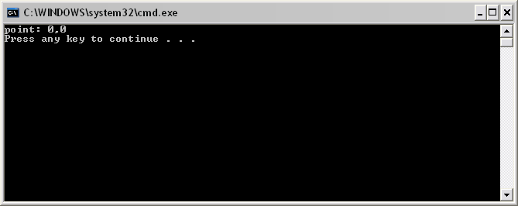
Example of Abstract Class and Method (2)
When use in Subclass
public class Point extends Shape {
static int x, y;
public Point() {
x = 0;
y = 0;
}
public double area() { return 0; }
public double perimeter(){ return 0; }
public static void print() {
System.out.println("point: " + x + "," + y);
}
public static void main(String args[]) {
Point p = new Point();
p.print();
}
}
Class Point is inheritance of abstract Class Shape
Area() function that overridden from its super-class.

Slide 7
Interface Introduction
Interface is a class like construct that contains only constant and abstract methods.
Interface is similar to an abstract class, but its intent is to specify common behavior for objects.
Declarations using keyword interface:
modifier interface InterfaceName{
}
In subclass using keyword implements.
Cannot be made the object with new operator

Slide 8
Example of Interfaces
When declare an interfaces
interface Shape {
public double area();
public double volume();
}
Declare class interface
Abstract Method

Slide 9
Example of Interfaces (2)
Using implement if you want to use interface
class Shape
When use in Subclass
public class Point implements Shape {
static int x, y;
public Point() {
x = 0;
y = 0;
}
public double area() { return 0; }
public double volume() { return 0; }
public static void print() {
System.out.println("point: " + x + "," + y);
}
public static void main(String args[]) {
Point p = new Point();
p.print();
}
}
2 Functions in interface class Shape
Should be overridden in subclass Point

Slide 10
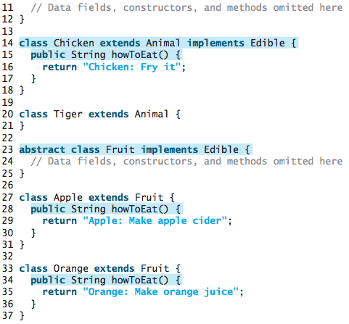

Interface in Advanced

Slide 11
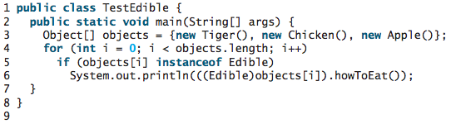
Interface in Advanced

Slide 12
Interface VS Abstract Class (1)
Difference of interfaces and abstract classes it is clear from its use. Interface was implemented and abstract class was derives (inherited).
 | Variables | Constructors | Methods
Abstract Class | Free, no limit, no restriction | Constructor can be call through subclass via constructor chain. Can not made the object | Free, no limit, no restriction
Interfaces | All variables should be declared public static final | No constructor. Can not made the object | All functions should be declared public abstract

Slide 13
Interface VS Abstract Class (2)
Java only allows single inheritance for class, but can be multiple for interfaces.
public class NewClass extends BaseClass implements Interface1, …, InterfacesN {
// ….
}
An interface can be inherit from other class using keyword extends.
public interface NewClass extends Interface1, …, InterfacesN {
// constant and abstract method
}

Slide 14
Assignment
In this assignment you are asked to create a program to calculate the area of some geometries : Rectangle, Triangle, Circle
This task is require to use abstract class

Slide 15
References
Daniel Liang, Y., 2015, Introduction to java programming, vol.10, Pearson Education, New Jersey.

Slide 16
Interface in Advanced

Slide 17
Interface in Advanced

Slide 18
Interface VS Abstract Class (1)
Difference of interfaces and abstract classes it is clear from its use. Interface was implemented and abstract class was derives (inherited).
 | Variables | Constructors | Methods
Abstract Class | Free, no limit, no restriction | Constructor can be call through subclass via constructor chain. Can not made the object | Free, no limit, no restriction
Interfaces | All variables should be declared public static final | No constructor. Can not made the object | All functions should be declared public abstract

Slide 19
Interface VS Abstract Class (2)
Java only allows single inheritance for class, but can be multiple for interfaces.
public class NewClass extends BaseClass implements Interface1, …, InterfacesN {
// ….
}
An interface can be inherit from other class using keyword extends.
public interface NewClass extends Interface1, …, InterfacesN {
// constant and abstract method
}

Slide 20
Assignment
In this assignment you are asked to create a program to calculate the area of some geometries : Rectangle, Triangle, Circle
This task is require to use abstract class

Slide 21
References
Daniel Liang, Y., 2015, Introduction to java programming, vol.10, Pearson Education, New Jersey.
Interfaces VS Abstract Class
http://www.javaworld.com/javaworld/javaqa/2001-04/03-qa-0420-abstract.html
http://www.javabeginner.com/abstract-class-interface.htm
http://mindprod.com/jgloss/interfacevsabstract.html
http://geekswithblogs.net/mahesh/archive/2006/07/05/84120.aspx

